Slide 1
FIR Workbook (lab_3)
SOC Design
National Tsing Hua University

Slide 2
Function specification
Same as course-lab_2(FIRN11stream)
y[t] = Σ (h[i] * x[t - i])

Slide 3
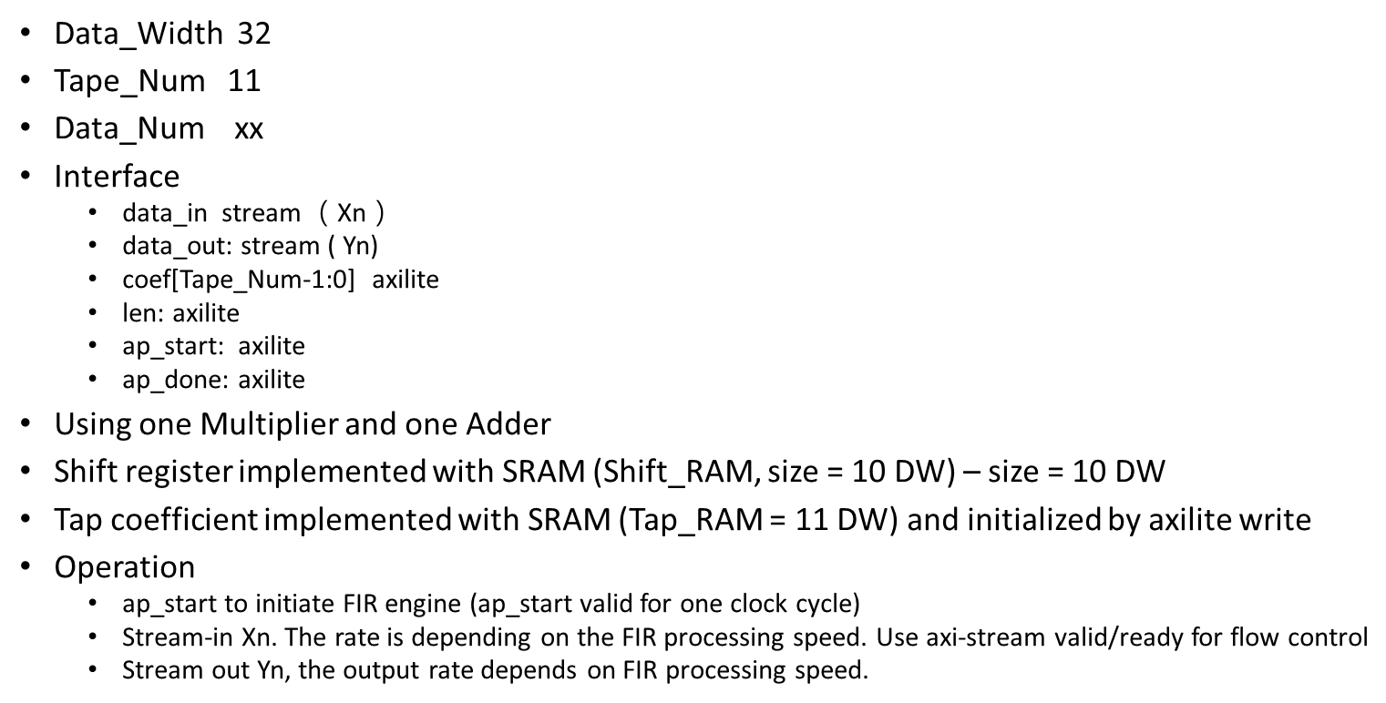
Design specification

Slide 4
Deliver module header
The I/O signals are listed in Fir.h.
You are requested to use AXI-lite and AXI-stream protocol.

Slide 5
FIR module interface
For your reference:
AXI-lite:
https://www.realdigital.org/doc/a9fee931f7a172423e1ba73f66ca4081
https://docs.xilinx.com/r/en-US/pg202-mipi-dphy/AXI4-Lite-Interface
AXI-stream:
https://developer.arm.com/documentation/ihi0051/latest/
https://docs.xilinx.com/r/en-US/pg256-sdfec-integrated-block/AXI4-Stream-Interface

Slide 6
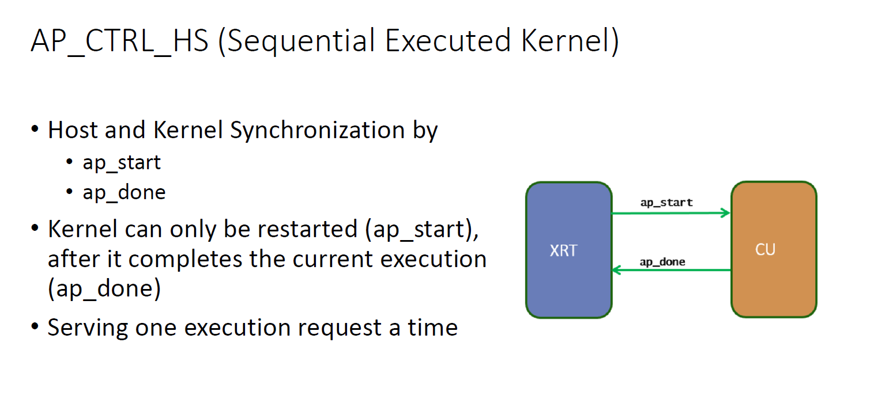
Testbench
fir_tb(Please name your top module same as fir.h for simulation)
The testbench should keep in the same directory with test dataset
Block-level Protocol (ap_start, ap_done):

Slide 7
Test dataset
Samples_triangular_wave.dat
out_gold.dat

Slide 8
Submission (1/2)
Hierarchy:
StudentID_lab3/
Waveform
Simulation.log
Report.pdf
Github link
Your Github link should attach the file mentioned above
Waveform, simulation.log, …etc.
Location of design (If use vivado to design)
hostproject/hostproject.srcs/sources_1/new/

Slide 9
Submission (2/2)
Compress all above files in a single zip file named
StudentID_lab3.zip (e.g., 111061545_lab3.zip)
Submit to NTHU eeclass
Deadline:
‐ 20% off for the late submission penalty within 3 days

